Slide 1
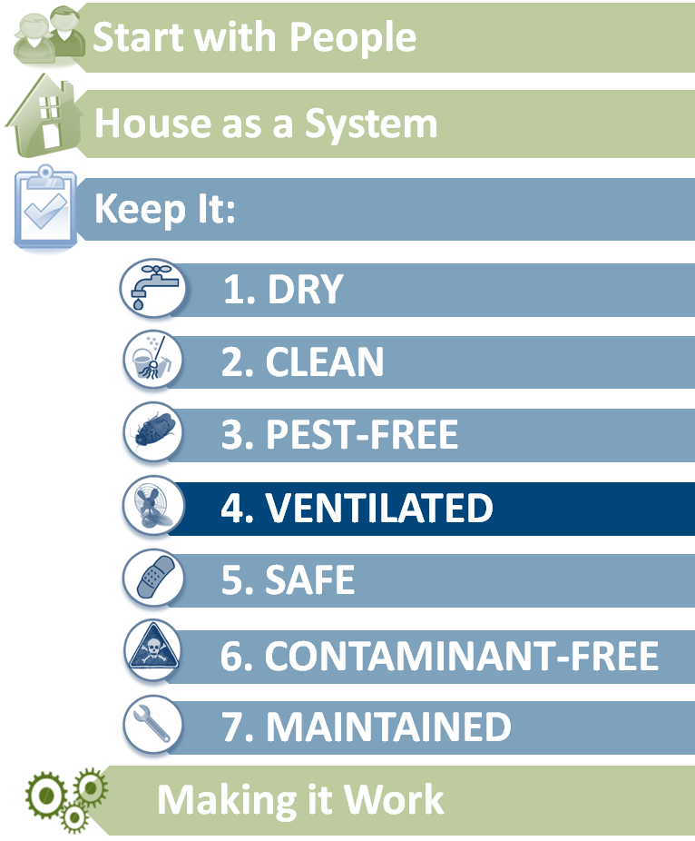
Keep it ventilated
Steps to Healthier Homes
Notes:
These are steps to reduce household hazards. People are not born knowing that they must brush their teeth to prevent decay, they must learn it. So with household hazards, they must learn how to take care of themselves. Occupants know things about the building and themselves that can be learned nowhere else. Start with the people.
The second step is to keep the household in a certain condition:
limit moisture related problems,
limit dust and allergens,
limit pest borne disease,
provide local exhaust ventilation and general dilution ventilation to control unavoidable air contaminants,
provide a comfortable space by limiting hazards like slips, falls, electric shock, drowning and poisons.
Third, limit sources of contaminants like lead, asbestos, combustion fumes, VOCs (Volatile organic compounds) and radon.
Fourth, maintain the house so it continues to provide dry, clean, comfortable and safe conditions.
Version 2.2

Slide 2
Learning Objectives
Name five unhealthy conditions associated with poor ventilation.
List five things ( e.g. a room, appliance, mechanical system) in a household that need ventilation.
Name three things that power airflow in a building.
List three household contaminants that can be removed by ventilation.
Describe two ways ventilation reduces air contaminant levels.

Slide 3
Why Well Ventilated?
Pollutants found in concentrations 2-5 times higher indoors than outdoors.
Proper ventilation can reduce hazards of:
Volatile organic compounds, moisture, environmental tobacco smoke, particulate matter, allergens, mold, carbon monoxide, Formaldehyde
Notes:
Proper ventilation can reduce hazards of:
Volatile organic compounds, moisture, environmental tobacco smoke, particulate matter, allergens, mold, carbon monoxide, Formaldehyde

Slide 4
Type of Heating Fuel
Water Heater
51% have piped gas
41% have electricity
Clothes Dryer
21% have piped gas
78% have electricity
From American Housing Survey – 2009

Slide 5
Primary Heating Equipment
63% have warm air furnace
11% have steam or hot water system
12% have electric heat pump
But . . .
1.1 million homes (1%) have room heaters without flue
1 million homes (0.9%) rely on stoves
111,000 homes (0.1%) rely on cooking stove
Primary heating equipment:
For their primary source of heat!
From American Housing Survey – 2009

Slide 6
Heating Problems
9% were uncomfortably cold for more than 24 hours
10% for renters
1% had inadequate heating capacity
2% for renters and residents below poverty level
0.8% had inadequate insulation
1.5% for renters
1.6% for residents below poverty level
From American Housing Survey – 2009

Slide 7
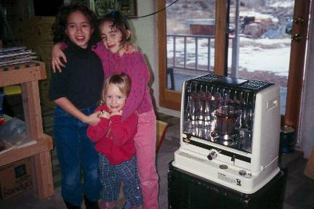
Sources of Combustion Contaminants
Oven as heater
Spillage from furnace, water heater, fireplace
Ventless heater or fireplace
Car exhaust from attached garage
Notes:
Combustion contaminants are not uncommon problem. This problem is popping up all over the country, mostly in new homes. Usually families notice a fine layer of soot appears on plastic surfaces, such as TV and computer screens, inside refrigerators and freezers, on walls and ceiling, on carpets, particularly under doors and at baseboards.
Unvented kerosene or gas heaters
Burning fuel without ventilation can produce nitrogen dioxide, carbon monoxide, and nitrogen oxide, as well as particles. Unvented combustion devices should not be used in occupied spaces. ^{[1]}
The kerosene heater in this home was used to provide supplemental heat, but the odor of the combustion products was so annoying that the door behind the heater was cracked open while the heater was in use.

Slide 8
Combustion Contaminants? Health Effects
Carbon Monoxide
Fatigue, headaches, dizziness, confusion
The “Silent Killer”
Nitrogen Dioxide
Eye, nose, and throat irritation
Shortness of breath
Notes:
There are two major pollutants associated with combustion products.
At relatively low levels of carbon monoxide a healthy person may feel fatigued. As levels increase a person may complain of headaches, dizziness, weakness or confusion. It is important to realize that CO is often referred to as the “Silent Killer” because it is colorless and odorless and death can occur without the person being aware that high levels exist. CDC reports that over 15,000 people each year are treated in emergency rooms for non-fire related carbon monoxide exposures. And an average of about 500 people die each year from non-fire related carbon monoxide exposures.
If a flame is yellow, it is not burning hot enough and it will produce more carbon monoxide. The hotter the flame, the most nitrogen dioxides produced.

Slide 9
Carbon Monoxide Limits
Agency | Situation | Maximum CO Level | Duration
Environmental Protection Agency (EPA) | Outdoor / Ambient Air | 9 ppm | 8 hours
 |  | 35 ppm | 1 hour
Consumer Products Safety Commission/Underwriter Laboratories (UL) | Alarms for Immediate Life Threats in Residential Air | 70 ppm | 1 - 4 hrs
 |  | 150 ppm | 10 - 50 min
 |  | 400 ppm | 4 - 15 min
Canadian Department of National Health & Welfare | Air in Residences | 11 ppm | 8 hours
 |  | 25 ppm | 1 hour
World Health Organization | Indoor Air | 32 ppm | Max.
Notes:
From CEHRC Carbon Monoxide Background Document.³ See www.cehrc.org/tools/carbon/cobacmat.cfm.
These are exposure limits for people at work for 8 hours a day or for outside air. What about people who are in their home virtually all the time?

Slide 10
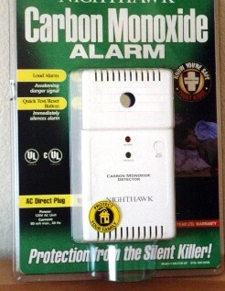
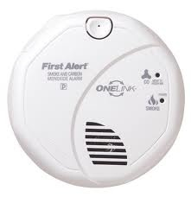
Carbon Monoxide Alarms
Consumer Product Safety Commission (CPSC) recommends:
Place near sleeping area
Put on every level of a home to provide extra protection
Do not install directly above or beside fuel-burning appliances
Combination smoke and CO alarm
Notes:
Proper placement of a carbon monoxide detector is important. If you are installing only one carbon monoxide detector, the Consumer Product Safety Commission (CPSC) recommends it be located near the sleeping area, where it can wake you if you are asleep. Additional detectors on every level and in every bedroom of a home provides extra protection.
Install a battery-operated CO detector in your home and check or replace the battery when you change the time on your clocks each spring and fall.
Homeowners should remember not to install carbon monoxide detectors directly above or beside fuel-burning appliances, as appliances may emit a small amount of carbon monoxide upon start-up. A detector should not be placed within fifteen feet of heating or cooking appliances or in or near very humid areas such as bathrooms.
Carbon Monoxide Detectors should not be thought of as a REPLACEMENT for proper use and maintenance of fuel-burning appliances. It is important for students to know that the technology of CO detectors is still developing, that there are several types on the market, and that they are not generally considered to be as reliable as the smoke detectors found in homes today. Some CO detectors have been laboratory-tested, and their performance varied. Some performed well, others failed to alarm even at very high CO levels, and still others alarmed even at very low levels that don’t pose any immediate health risk. And unlike a smoke detector, where you can easily confirm the cause of the alarm, CO is invisible and odorless, so it’s harder to tell if an alarm is false or a real emergency.

Slide 11
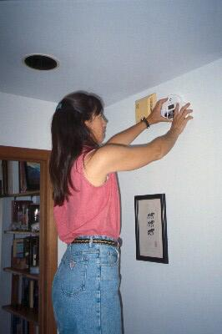
CO Alarm Installation
Should be installed:
According to the manufacturer's instructions
One CO alarm should be installed in the hallway outside the bedrooms of each separate sleeping area of the home
Notes:
Placing and maintaining a CO alarm
According to the Consumer Product Safety Commission guidance, “CO alarms should be installed according to the manufacturer's instructions. CPSC recommends that one CO alarm be installed in the hallway outside the bedrooms in each separate sleeping area of the home. CO alarms may be installed into a plug-in receptacle or high on the wall. Hard wired or plug-in CO alarms should have battery backup. Avoid locations that are near heating vents or that can be covered by furniture or draperies. CPSC does not recommend installing CO alarms in kitchens or above fuel-burning appliances.”
http://www.cpsc.gov/cpscpub/pubs/466.html
Some students may have concerns about where the person is placing the CO monitor. Some manufacturers would say that this is too high on the wall. In the past, manufacturers would recommend that the monitor be placed away from the corner of the ceiling in order to be more in the pathway of airflow. But more recently, manufacturer instructions are less specific. It really depends on the manufacturer so you should tell students that anyone installing a CO monitor should follow the instructions for that specific device carefully.
For example, several web sites advise:
When considering where to place a carbon monoxide detector, keep in mind that although carbon monoxide is roughly the same weight as air (carbon monoxide's specific gravity is 0.9657, as stated by the EPA; the National Resource Council lists the specific gravity of air as one), it may be contained in warm air coming from combustion appliances such as home heating equipment. If this is the case, carbon monoxide will rise with the warmer air.
Installation locations vary by manufacturer. Manufacturers' recommendations differ to a certain degree based on research conducted with each one's specific detector. Therefore, make sure to read the provided installation manual for each detector before installing.
In this photo, a CO alarm is being placed next to a smoke alarm in the hallway outside of a frequently-occupied bedroom. Check or replace the battery when you change the time on your clocks each spring and fall.
A CO alarm should be tested by pressing the TEST button. A common cause of failure is weak or missing batteries, which should be replaced routinely. Most alarms have a 5 year life span.

Slide 12
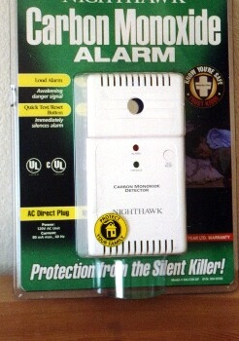
Why Ventilated
Health effects
Approximately 500 carbon monoxide deaths plus more than 15,000 non-fire related healthcare visits per year.
Notes:
Here are some surprising statistics regarding ventilation in the home that are supplied by the Homes Safety Council. ^{[4]}

Slide 13
Why Ventilated
Health effects
Higher rates of respiratory irritation and illness in housing with poor ventilation
Common colds
Influenza
Pneumonia
Bronchitis
...and increased rates of absence from school or work
Notes:
Ventilation plays an important role in maintaining health. Poor ventilation can result in higher rates of respiratory irritation, common colds, influenza, pneumonia, and bronchitis.
A recent study stated the following^{[5]}:
a 70% higher respiratory illness in fan-ventilated classrooms compared to window ventilated rooms;
Nursing homes had much lower (76%) influenza rates in buildings with 100% supplied outside air
With improved ventilation in housing and buildings, illnesses could decrease in incidence by 18% and costs to the US economy could be decreased by $6-14 billion.

Slide 14
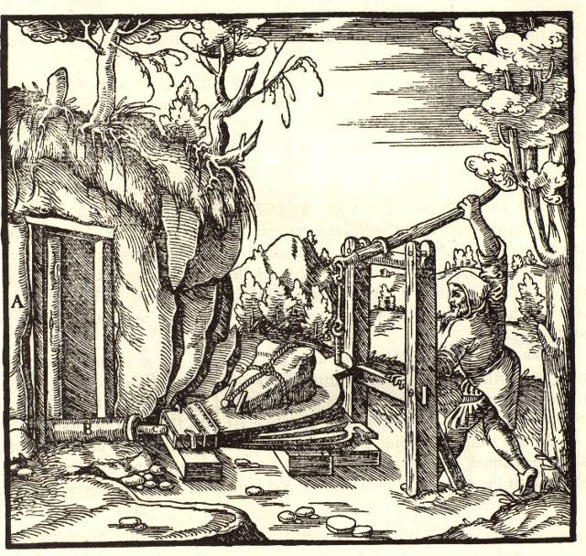
Well ventilated?
Notes:
Ventilation equipment is the visible evidence of a long history of indoor air quality, heat, and moisture problems. Why else would we have invented it?
This is a photo of a woodcut showing a worker pumping air into a mine shaft to provide ventilation for his fellow workers. The woodcut is from De Re Metallica, a text on mining and metallurgy written in 1556 by Georgius Agricola. Agricola describes many of the ailments suffered by miners and the solutions for them, among which is “stagnant air…which… produces a difficulty in breathing; the remedies for this evil are the ventilating machines.”
The chapter on ventilation shows three types of ventilators – scoops to divert wind into the mine, fans resembling radial blowers powered by men, water turbines or wind mills, and bellows powered by men or horses.
Indoor air quality problems are not new and the benefit of ventilation has long been understood.

Slide 15
A Well-Ventilated Building?
Notes:
Is there a difference between a building with plenty of air flow and one that is well-ventilated?

Slide 16
Good Building Ventilation Provides:
Local Exhaust Ventilation
Whole House Ventilation
Control of airflow through building
to remove moisture, odors, and other pollutants at the source
for supplying fresh air to reduce contaminants by dilution
so crazy airflows can’t carry contaminants into and around the house
Notes:
Ventilation reduces air contaminant levels in two different ways:
If contaminants are released from a point source, a local exhaust system can be used to collect the contaminants before they spread throughout the building (e.g. chimneys, toilet exhaust, dryers and range hoods)
Outdoor air with low air contaminant levels can be drawn or blown into the building and mixed with the indoor air through a whole house ventilation system, lowering the concentration by dilution. The contaminant leaves the building in the exhaust air.
By using ventilation or conditioning air to manage pressure differences, the airflow through a building can be planned to minimize exposures in the most efficient way.
Local exhaust ventilation is more efficient than dilution ventilation because it collects the contaminant near the source and intervenes in the transport mechanism. This is why we use local exhaust ventilation for radon removal.

Slide 17
Understanding Ventilation
Key Concepts
If any portion of air leaves a house the same amount will enter
Air like water seeks the path of least resistance
When heated air rises
When cooled air falls
Air can be hot, cold, wet, dry, or polluted when it enters or exits a house

Slide 18
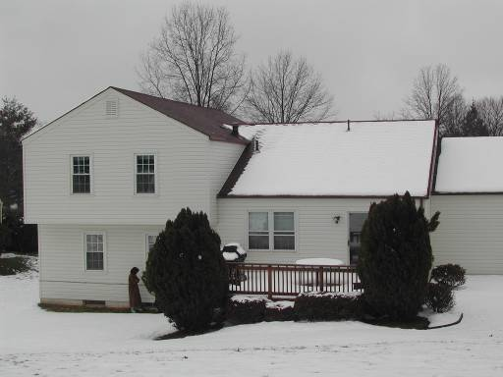
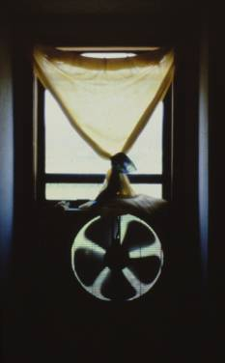
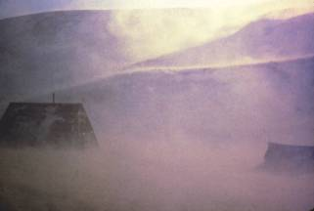
What Powers Air Flow?
Temperature differences
Fans
Wind
Notes:
Air moves through buildings, because a force creates differences in air pressure. The source of the force is most frequently some combination of fans, air temperature differences, and wind. It is easy to understand how fans and wind ventilate and cause air to move through buildings.

Slide 19
Air Flow in Homes
Typical homes do not have a planned supply of fresh air.
We depend on leakage such as windows, doors, and cracks.
This is usually not adequate.

Slide 20
Air Flow Needs Designed Holes
Chimneys
Bath and kitchen
exhaust vents
Fresh air inlet/outlet
Combustion
vents
Ventilation intake
and exhaust
Dryers
Central vacuum outlet
Notes:
Courtesy of Arnie Katz at Advanced Energy.
Key points:
Never block, restrict or seal designed holes
Never reverse the direction of designed flow

Slide 21
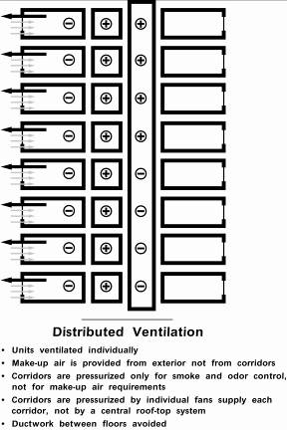
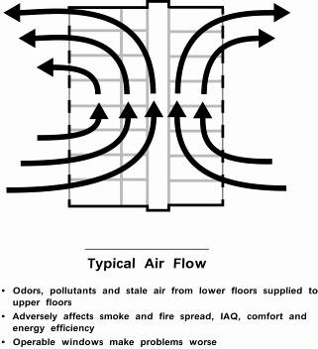
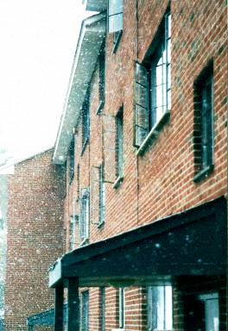
Multi-family dwellings should have planned
fresh air supply because:
Neighbors are closer together
Stack effect- this dominates in cold weather
Notes:
In cold weather, air passes through multi-story buildings from bottom to top. Notice the photo in the center. Cold air drawn in at the bottom of the building chills the lower floors; warm air rising through the building overheats the upper floors and people open their windows in an effort to cool off. The upper floors have no outdoor air during this time – only air that has passed through the floors below.

Slide 22
What are we looking for?
Bath, dryer, and range exhaust fans?
Gas stove used as heater?
Windows work?
Smoke alarm goes off?
Unvented gas or kerosene heaters?
Vented hot water heater?
Furnaces, boilers, fireplaces vented?
Rooms without windows?
Lingering odors?
Stale air?
Windows fog?
Notes:
When assessing a house for ventilation, check to see if the important stationary sources have effective exhaust ventilation and whether there is enough general dilution ventilation.
Local exhausts are easy enough to check – are they there, do they work? Because most residential buildings assume that operation of the local exhausts, wind and stack driven air flows, and operable windows provide enough general ventilation, it is more difficult to assess general ventilation. The simplest way to get an idea is to ask the occupant whether odors linger, windows fog during cold weather, or does the air seem stale?
To go beyond this level requires a fair amount of knowledge and less common test equipment (e.g. blower doors).

Slide 23
Things that Need Exhaust Ventilation
Bathrooms
Clothes dryers
Kitchen ranges
Boilers, furnaces, hot water heaters
Fireplaces, wood burning stoves
Notes:
Here is a list of rooms and appliances in a home that need exhaust ventilation.

Slide 24
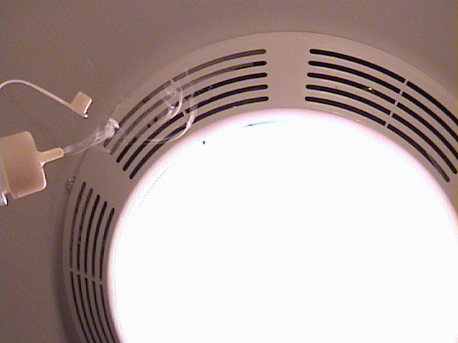
Is there an exhaust in the bathroom?
Does it work?
Notes:
Bathrooms are sources of moisture and odors. An exhaust vent should be located in each one. A single fan ducted to the bathrooms is a simple way of doing this.
A chemical smoke bottle can quickly answer the question: is it moving air the right way?
Chemical smoke allows you to quickly understand how air is moving around a building. It is one of the most powerful tools for solving indoor air quality, condensation and comfort problems. Chemical smoke is a strong irritant and should be used carefully. Do not let people in the home keep it.

Slide 25
Testing Exhaust Fan: The Charmin Method
Notes:
Placing toilet paper over the fan only tells you if the fan is actually pulling some air. A large percentage of installed fans don’t even pass this test!

Slide 26
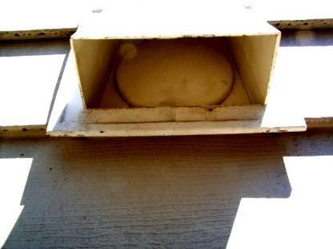
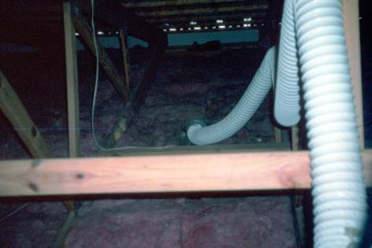
Damper work?
Ducted ok?
Notes:
Why bother testing exhaust fans? A recent program, in which exhaust fans were tested in over 300 new homes, found about 20% were pulling less than 15 cfm, despite being properly sized (most were 70 cfm fans) and properly ducted. The problem was that the backdraft dampers, either on the unit itself or on the termination or both, were taped shut to avoid damage while shipping and the installer didn’t remove the tape.

Slide 27
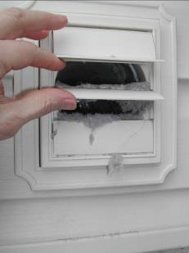
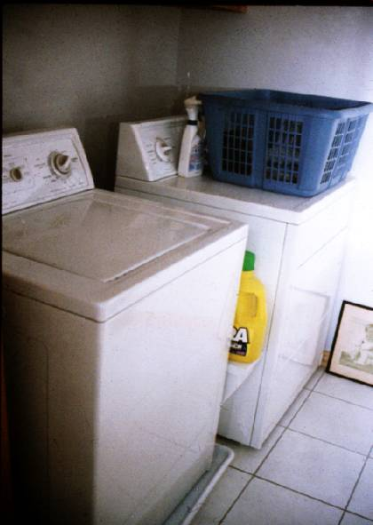
Notes:
Although most people do not think of them in this way, dryers are exhaust vented devices. Dryer exhausts use from 75 to 150 cfm of air to remove heat, lint, the perfumes from fabric softeners and in the case of gas fired dryers, combustion fumes. The amount of air exhausted by a dryer depends on how heavily it’s loaded, the amount of lint on the filter and the resistance of the flex duct used to exhaust the air.

Slide 28
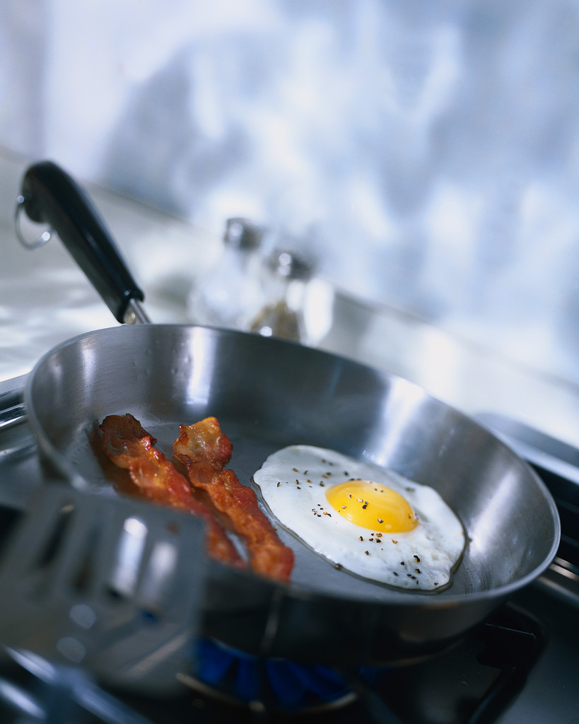
Local Ventilation: Kitchen
Remove moisture, odors, grease
If gas oven or range, remove products of combustion:
Must be vented to the outside
If it is not reasonably quiet, many people will not use it.
moisture, CO, NO2
Notes:
Kitchen ranges and ovens are the source of many contaminants. ^{[1,8]}
Since grease tends to collect on kitchen exhaust fans, they need to be cleaned frequently. A buildup of grease can attract cockroaches.

Slide 29
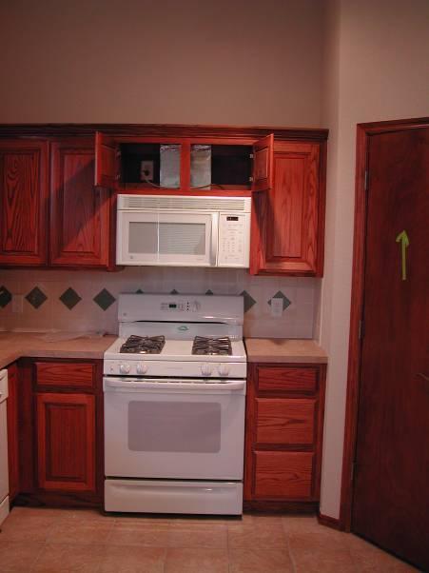
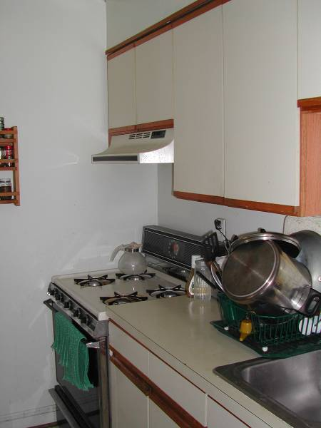
Notes:
On the left is a vented range hood. Notice the duct in cabinet. On the right is a recirculating range hood (not vented) that has no duct in cabinet but has a grille on upper surface of hood – this is not ideal.

Slide 30
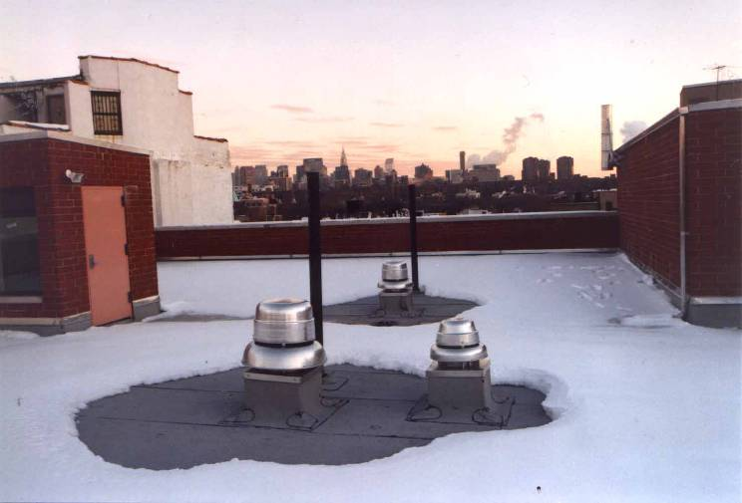
Multi-family exhaust only – new construction
Notes:
Rooftop fans provide exhaust ventilation for a six story multi-family building. Vertical ducts connect all the floors. Air may pass from one apartment through the ductwork and into another if the fans are not running, there is a problem with fan flow, the ducts are leaky or the stack effect overwhelms the system.

Slide 31
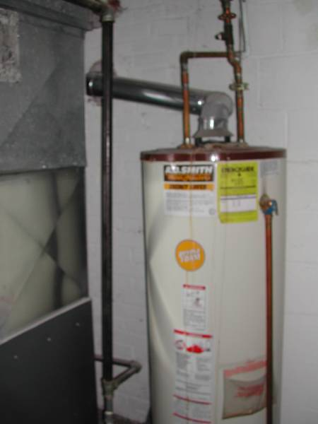
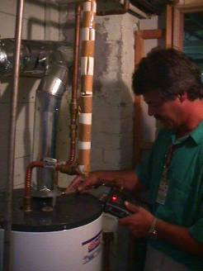
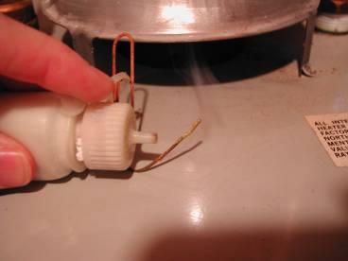
Notes:
An atmospherically vented gas fired hot water heater, vented through a B-vent (double wall-steel flue). In a tug of war for make-up air between the gas fired hot water heater and an exhaust fan, it may be the exhaust fan that wins. Atmospherically vented combustion devices can be tested for spillage using ASHRAE guidance.

Slide 32
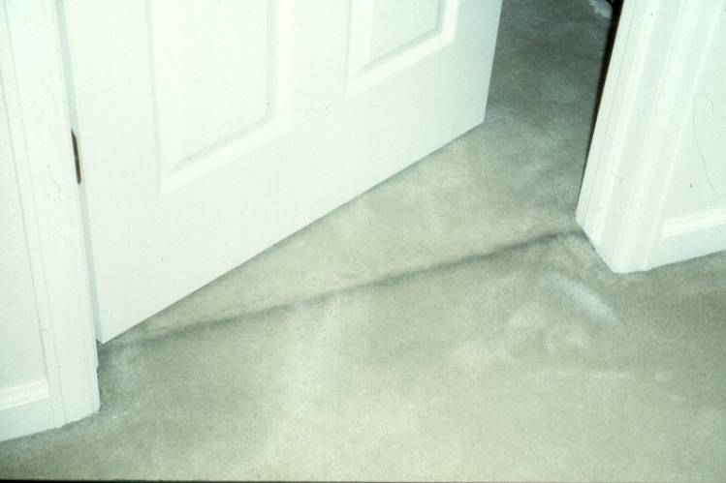
Notes:
Soot filtered from the air passing beneath the door when it is closed. This is an example of a pressure differential.

Slide 33
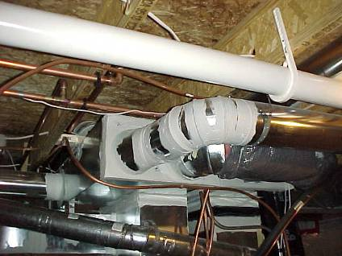
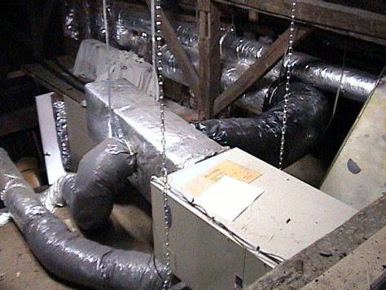
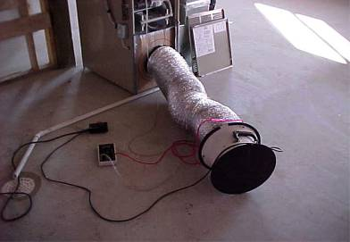
Leaks in ducts:
Cause pressure imbalance
“Mine” contaminated air from garages, crawlspaces
Increase energy costs
Does this look bad?
Notes:
Leaks in ductwork can also create pressure difference problems. The leaks in the return side of an air handler can “mine” contaminated air from anywhere the leaks draw air (e.g. crawlspaces, attics, basements). The two photos show poorly constructed ducts on the right and well-sealed (using mastic and mesh) on the left. Duct tape does not last.
Photo 1 (upper left hand corner) is a good representation of how ducts should be properly sealed (using mastic and mesh). However, this is probably a commercial HVAC system, due to the size of the unit and ducting itself.
Photo 2 (lower left hand corner) is illustrating how a duct blaster is attached to a residential HVAC system. Once attached, the unit is turned on and the ducts are pressurized, at which point, a technician is able to determine how much duct leak is occurring and from where in the system.
Photo 3 (lower right hand corner) may cause a fair amount of discussion in your classes as many people don’t feel this is all that bad, considering that the installation is in an attic.
Good things in photo
- The flexible ducting is well-insulated
- The flexible ducting is attached to rigid ducting using zip ties, which is certainly better than having used duct tape
Bad things in photo
- The flexible ducting has a number of twists and turns which could reduce airflow to certain registers within the home
- The flexible ducting is corrugated, which again could reduce airflow, because the corrugations disrupt air and does not allow for
smooth, laminar flow as would be the case in rigid ducting
- Since the unit is in the attic, one can imagine that it would be difficult for the homeowner to routinely check and change filters
in the HVAC system
- Since the unit is in the attic, if the condensate line or condensate drip pan becomes clogged, it would almost certainly result in
wetting and possible damage to ceiling and wall materials.
- Additional problem with attic furnaces is that they are less efficient because they are working against nature by trying to force warm air down into the living space and sucking the cooler return up. The natural state is that cooler more dense air tends to fall as warmer less dense air rises.

Slide 34
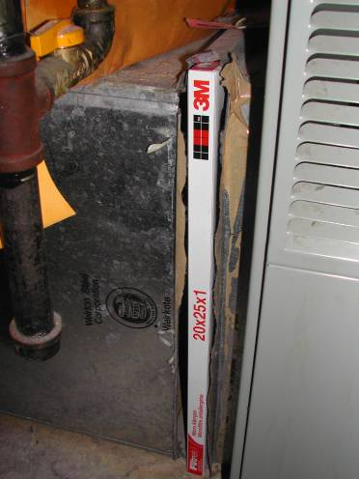
Poorly sealed filter access panel
Notes:
Filtration serves a number of purposes:
It protects coils from clogging with dust;
At high enough efficiencies it protects coils and ductwork from collecting deposits of fine particles that could support fungal growth if wetted (25% dust spot efficiency); and
And at high enough efficiencies it begins to collect fine enough particles and is a benefit to the lungs of the occupants (25% dust spot efficiency).

Slide 35
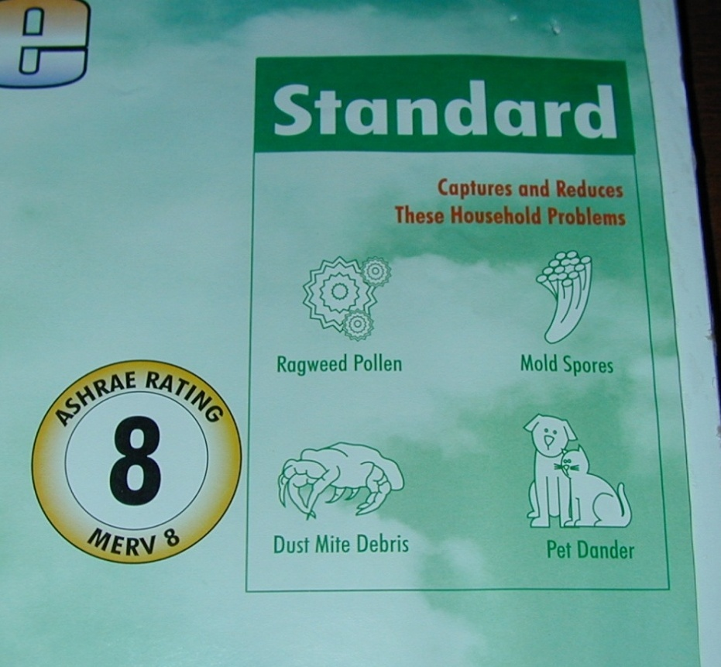
MERV- Filter Rating System
Minimum Efficiency Rating Value (MERV)
ASHRAE Standard 52.2 – Efficiency in collecting very small particles
Notes:
MERV, the Minimum Efficiency Reporting Value, is a new method of rating air cleaning devices. ^{[5]} It is based on the removal efficiency for particles of different sizes. Remember the size of the particle plays a role in whether or not it can be taken into the lungs.

Slide 36
Merv Ratings
MERV Ratings
MERV | Particle size | Typical controlled contaminant
1-4 | >10.0 | Pollen, sanding dust, textile and carpet fibers
5-8 | 3.0-10.0 | Mold, spores, hair-spray, cement dust
9-12 | 1.0-3.0 | Legionella, lead dust, welding fumes
13-16 | 0.3-1.0 | Bacteria, most tobacco smoke, insecticide dust, copier toner
17-20 | ≤ 0.3 | Virus, combustion particles, radon progeny
Notes:
MERV is intended to help simplify the air cleaner selection process for users. It is derived by combining the cleaner’s average efficiency at removing three particle size fields. If a high MERV filter is used with a fan designed for something lower there may be inadequate airflow.

Slide 37
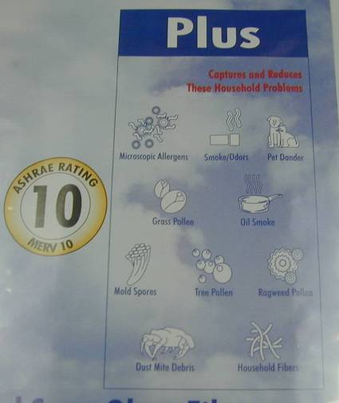
MERV 8 vs. 10

Slide 38
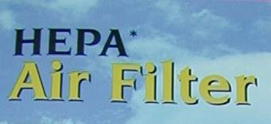
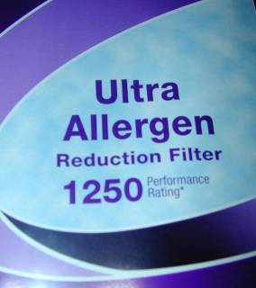
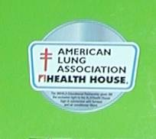
Other Rating Systems
Notes:
The High Efficiency Particulate Air (HEPA) filter is designed to capture airborne particulates (solids) down to 0.3 microns in size. The HEPA media looks like blotting paper. It is made of very thin glass fibers fashioned into a sheet much the same way as wood fibers are used to make paper. Air passing through the media must continually change direction in order to pass around the thin glass fibers. Large particles can not make these sharp turns without colliding into and becoming captured by the HEPA media. To qualify as a HEPA filter, the filter must collect 99.97% of a specific particulate that measures 0.30 microns,
Please note that “HEPA-type” filters and filters labeled for allergen control have not been certified that they meet the standard.
The MERV (Minimum Efficiency Reporting Value) rating of a filter describes the size of the holes in the filter that allow air to pass through. The higher the MERV rating, the smaller the holes in the filter, and the higher the efficiency. MERV 8 filter media should not promote the growth of bacteria, mold, mildew, or fungi in normal operating environments, and are not chemically treated.

Slide 39
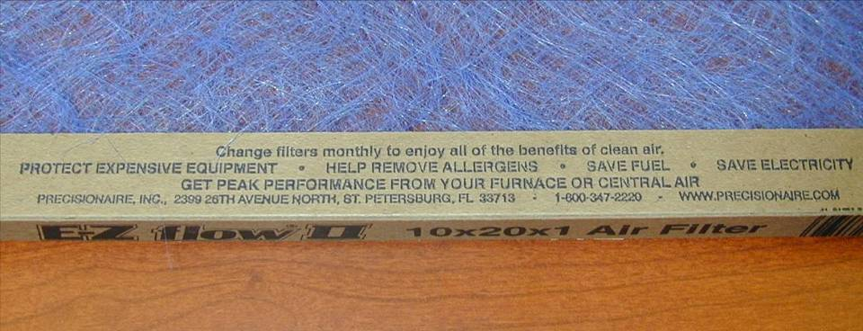
And . . .
Notes:
Discuss these claims. This filter is probably only a MERV 4.

Slide 40
Code Requirements
Code requirements related to ventilation
403.1
403.2
Habitable spaces
Bathrooms and toilet rooms
Notes:
403.1Habitable spaces.
Every habitable space shall have at least one open-able window.
The total open-able area of the window in every room shall be equal to at least 45 percent of the minimum glazed area required in Section 402.1.
403.2 Bathrooms and toilet rooms.
Every bathroom and toilet room shall comply with the ventilation requirements for habitable spaces as required by Section 403.1, except that a window shall not be required in such spaces equipped with a mechanical ventilation system.
Air exhausted by a mechanical ventilation system from a bathroom or toilet room shall discharge to the outdoors and shall not be recirculated.

Slide 41
Code Requirements
Code requirements related to ventilation
302.6
403.5
Exhaust vents
Clothes dryer exhaust
403.4
Process ventilation
Notes:
302.6 Exhaust vents.
Pipes, ducts, conductors, fans or blowers shall not discharge gases, steam, vapor, hot air, grease, smoke, odors or other gaseous or particulate wastes directly upon abutting or adjacent public or private property or that of another tenant.
403.4 Process ventilation.
Where injurious, toxic, irritating or noxious fumes, gases, dusts or mists are generated, a local exhaust ventilation system shall be provided to remove the contaminating agent at the source. Air shall be exhausted to the exterior and not be recirculated to any space.
403.5 Clothes dryer exhaust.
Clothes dryer exhaust systems shall be independent of all other systems and shall be exhausted in accordance with the manufacturer’s instructions.

Slide 42
Code Requirements
Code requirements related to ventilation
603.2
Removal of combustion products
607.1
General
603.5
Combustion air
505.4
Water heating facilities
Notes:
603.2 Removal of combustion products.
All fuel-burning equipment and appliances shall be connected to an approved chimney or vent.
Exception: Fuel-burning equipment and appliances which are labeled for unvented operation.
607.1 General.
Duct systems shall be maintained free of obstructions and shall be capable of performing the required function.
603.5 Combustion air.
A supply of air for complete combustion of the fuel and for ventilation of the space containing the fuel-burning equipment shall be provided for the fuel-burning equipment.
505.4 Water heating facilities.
Water heating facilities shall be properly installed, maintained and capable of providing an adequate amount of water to be drawn at every required sink, lavatory, bathtub, shower and laundry facility at a temperature of not less than 110ºF (43ºC).
A gas-burning water heater shall not be located in any bathroom, toilet room, bedroom or other occupied room normally kept closed, unless adequate combustion air is provided.
An approved combination temperature and pressure-relief valve and relief valve discharge pipe shall be properly installed and maintained on water heaters.

Slide 43
Key Messages
Ventilation plays an important role in maintaining health.
Ventilation is necessary to remove humidity and dilute or remove contaminants.
Local exhaust ventilation removes contaminants from a point source, while whole house ventilation uses fresh air to dilute contaminants.

Slide 44
Learning Objectives
Name five unhealthy conditions associated with poor ventilation.
List five things ( e.g. a room, appliance, mechanical system) in a household that need ventilation.
Name three things that power airflow in a building.
List three household contaminants that can be removed by ventilation.
Describe two ways ventilation reduces air contaminant levels.

