Slide 1
What Does “Healthy Homes” Really Mean and WHY Should We Care?
November 28, 2011

Slide 2
Homes Shelter Us From:
Animals and insects
Human intruders
Wind
Sun
Rain (sleet and snow)
Cold or hot air
Dust
Notes:
Let’s start with a reminder of why we live in houses in the first place.
Our homes protect us from all sorts of bad things: wild animals, insects and pests, bad people, extreme temperatures, wind and rain and snow.
Our houses are supposed to keep us safe and secure.

Slide 3
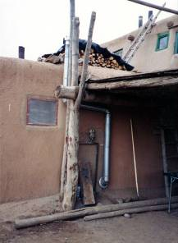
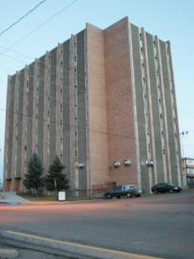
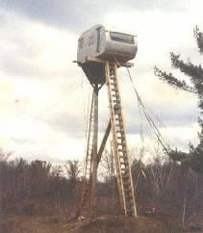
What’s a House?
Notes:
Houses come in lots of different shapes and sizes.
Some people associate “healthy homes” with new construction – homes with all kinds of electronic controls that we can access with an iPhone app.
Of course, we want newly built homes to be healthy – and there are clearly opportunities in the selection of materials, design, and construction techniques to make homes healthier.
But NCHH is focused on “the 99%” of existing homes and apartments – and opportunities to make them healthier through maintenance, repair, rehab and occupant education.

Slide 4
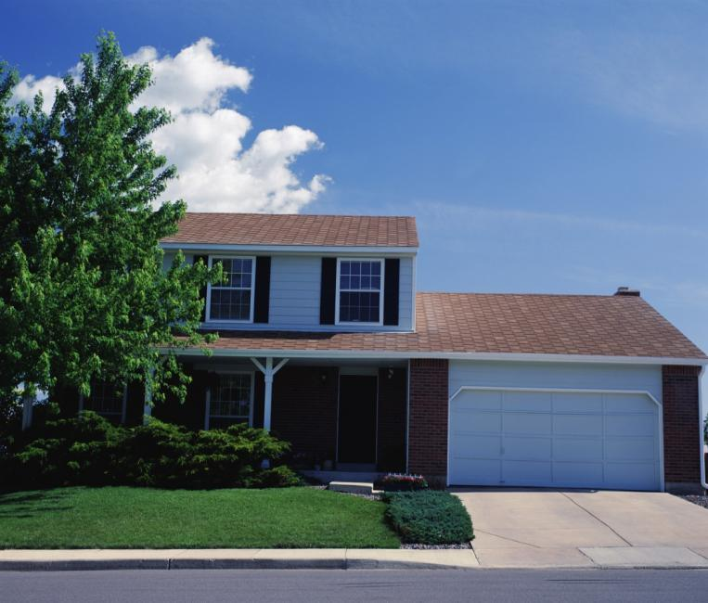
A House Is a System
Notes:
We tend to think of houses as structures – as boxes put together in different combinations and shapes.
But in truth, every house is a complex system – in fact, they’re multiple systems that interact with each other.

Slide 5
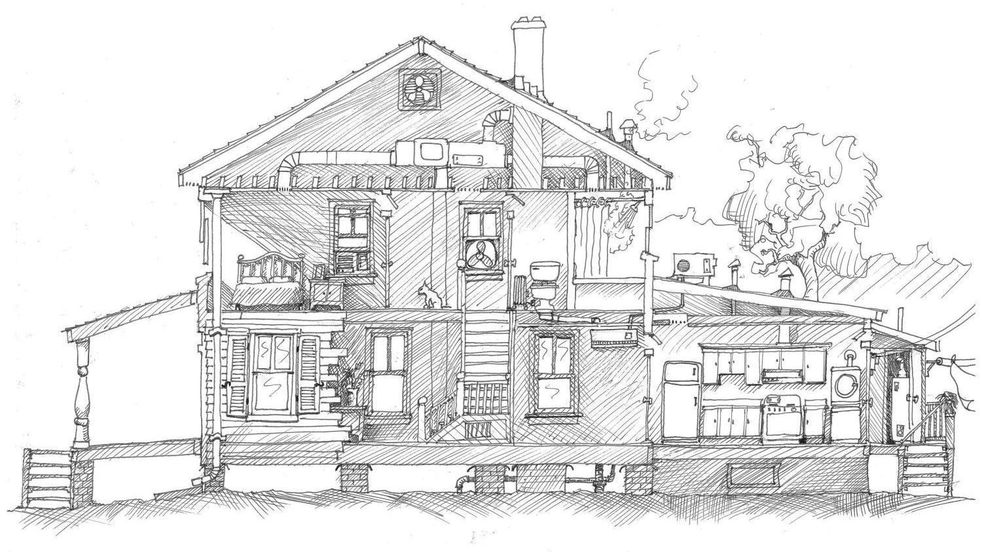
Notes:
Houses have many different kinds of spaces.
Different rooms have different functions – kitchens, bathrooms, bedrooms, et cetera.
And in addition to the living space, our homes have attics, and basements, and utility rooms – and sometimes crawlspaces.

Slide 6
An Interactive System
Air Flow
Heat Flow
Moisture Flow
Notes:
In every house, we need to pay special attention to how three things move:
How air flows in and out of the home,
How heat transfers, and
How moisture flows in and out.
Changing any one of these may impact the others -- and can directly affect the health of the people in the house.

Slide 7
Why Worry About Healthy Homes?
Young children spend about 70% of the time in their homes.
Many seniors spend 90%+ of their time in their homes.
Notes:
One reason our homes impact our health so greatly is simply because we spend so much time in our homes.
This is especially true for the very young and the very old, two populations who are most sensitive.
Thousands of peer-reviewed research studies have documented the multiple ways that our homes affect our health, and the scientific evidence is growing steadily.

Slide 8
What Is Healthy Housing?
Healthy housing is…
Sited
Designed
Constructed
Maintained; and
Rehabilitated
…in a manner that is conducive to good occupant health.
Notes:
Here’s the definition of “healthy housing” that the National Center uses.

Slide 9
2009 American Housing Survey
Exterior problems:
4.2% - missing roof material
9.8% - exterior water leakage
18.6% - exterior physical problems
Notes:
And how does our housing stock measure up? Unfortunately, not well.
The American Housing Survey, which is done as part of the U.S. Census, found exterior problems in millions of homes:
Almost 5% of American homes have roof problems.
Almost 10% have exterior water problems.
Almost 20% have some kind of exterior defect.

Slide 10
2009 American Housing Survey
Interior Problems:
8.1% - interior water leakage
4.9% - open cracks or holes
3.4% - pipes leaked
5.5% - mice
8.7% - blown fuses or breakers
Safety Devices:
5.5% - no working smoke alarm
55% - extinguishers more than two years old
64% - no carbon monoxide alarm
Notes:
And things are even worse inside: water leaks, cracks and holes, and electrical problems.
More than 5% of homes have mice, more than 5% have no smoke alarm, and almost two thirds have no carbon monoxide detector.
And of course, these statistics reflect national averages. Older home occupied by low-income households are even more likely to pose hazards.

Slide 11
Asthma
Asthma costs $18 billion per year, about 3% of all healthcare costs.
Asthma accounts for more than 10 million missed school days a year.
Black children have 2-3 times higher rates of hospitalization for asthma – and are five times more likely to die from asthma.
Notes:
In the 1980s, hazards from lead-based paint first directed national attention to how our housing affects our health. More recently, the role housing plays in the growing prevalence of asthma has commanded attention.
Asthma is a complicated disease with both genetic and environmental components that doctors and scientists are still sorting out.
But the science is clear that health hazards in housing play a significant role – both in sensitizing children to asthma as well as triggering attacks.
Over the past few years, the emphasis of research has shifted from developing better drugs to understanding the environmental factors involved.
Asthma costs the U.S. health system billions of dollars – and is the leading cause of missed school days. And of course, when kids stay home from school, their parents usually miss work.
And studies show that housing interventions are effective in reducing asthma.

Slide 12
Asthma Triggers
Secondhand smoke
Dust mites
Mold
Cockroaches
Rat and mouse dander
Pet dander
Low-income housing has higher exposures.
Notes:
Solid research has found that each of these six housing-related factors can trigger asthma attacks.
And, once again, these risk factors are significantly higher in low-income families’ homes.

Slide 13
Childhood Asthma 1980 to 2005
Notes:
Keep in mind that asthma is just one housing-related health hazard.
But the 8-10% of young children in most states are a pointed reminder that our housing directly affects our health.
About 40% of asthma cases are attributable to the home environment.

Slide 14
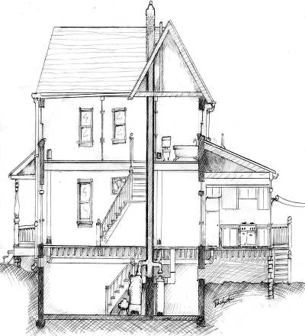
Healthy Homes Principles
Keep it:
Dry
Clean
Pest-Free
Ventilated
Safe
Contaminant-Free
Maintained
Notes:
The many ways that our homes affect our health can be confusing, even overwhelming. NCHH uses these seven principles to focus attention and action on ways to make our homes healthier.
In a minute, we are going to take whirlwind tour to translate these principles into specific examples of housing-related health hazards.
As we go through these, I want to ask you to keep three things in mind:
Note that many problems are overlapping and interrelated, such that correcting a single problem can produce multiple health benefits.
Note how many health hazards in the home are linked to housing code violations.
Note that most of the fixes are fairly low-cost and low-tech.
Second, note how many remedies are relatively low-cost and low-tech – practical opportunities to make every home healthier.

Slide 15
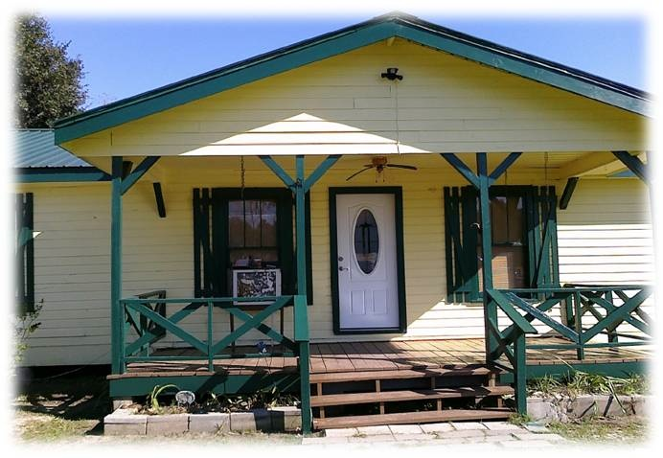
Keep It Dry
Notes:
The first principle of healthy homes is Keep It Dry.
We start with Keep It Dry because moisture is the root cause of many evils.

Slide 16
Moisture Causes a Host of Health Hazards
Mold
Dust mites
Cockroaches
Other pests
Allergens
Structural damage (wood rot)
Paint failure (creating lead hazards)
Notes:
Keep in mind, the first four items listed are confirmed asthma triggers.

Slide 17
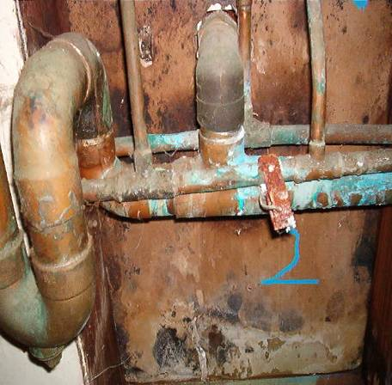
IOM Report Mold- and Moisture-Related Health Effects
Upper respiratory tract symptoms
Coughing
Wheezing
Asthma
Hypersensitivity pneumonitis
Notes:
In 2004, the Institute of Medicine issued a major report on moisture and mold and respiratory disease.
It found the prevalence of asthma or respiratory symptoms to be twice as high for occupants of homes or schools that have moisture or mold problems.

Slide 18
How Water Enters a Building
L
e
a
k
Cooking,
s
Bathing,
(
l
i
q
u
i
d
)
Watering
Plants,
Breathing,
Washing
(water vapor)
S
u
r
f
a
c
e
w
a
t
e
r
(
l
i
q
u
i
d
)
A
i
r
F
r
o
m
S
o
i
l
(
w
a
t
e
r
v
a
p
o
r
)
G
r
o
u
n
d
w
a
t
e
r
(
l
i
q
u
i
d
)
Notes:
There are many different causes of moisture problems in our homes:
roof leaks
foundation leaks
plumbing leaks
humid outside air coming inside
condensation
cooking and bathing

Slide 19
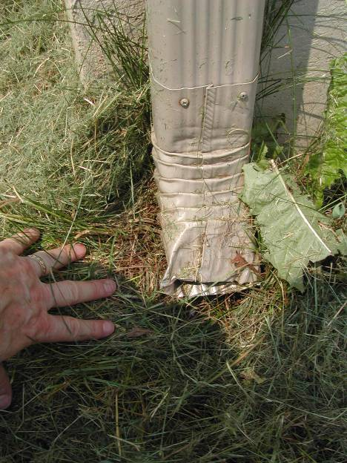
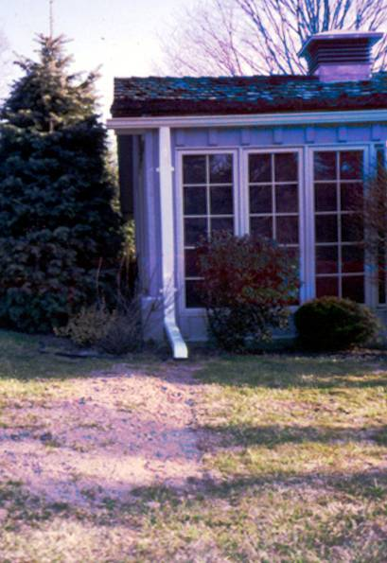
Notes:
The downspout on the left dumps runoff water right next to the foundation – and note that the downspout opening has been crushed.
Compare that to the house on the right, where the downspout feeds into landscaping pipe that carries runoff well away from the home.

Slide 20
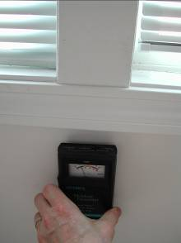
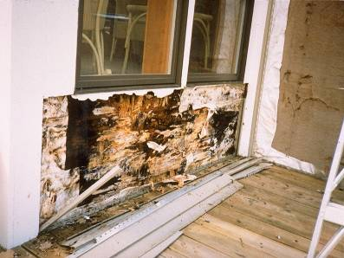
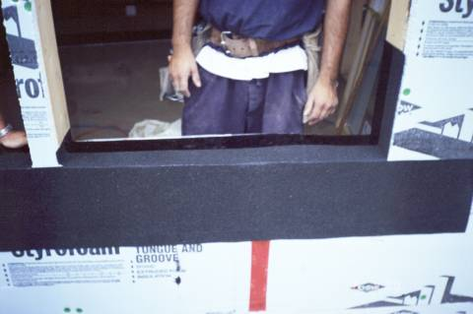
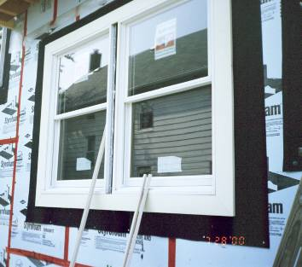
Windows leak?
Notes:
Windows can leak rainwater at mitered corners and where two windows are mulled together.
Many windows leak around the edges due to poor flashing.
An unattended water leak can cause enormous damage – in very little time – as the top photo illustrates.

Slide 21
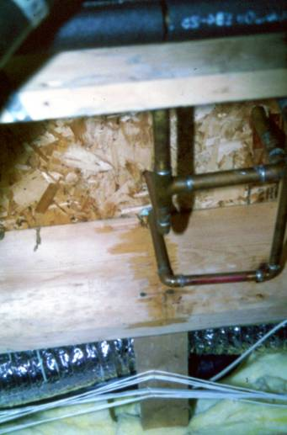
Plumbing leaks are another
common cause of
moisture damage

Slide 22
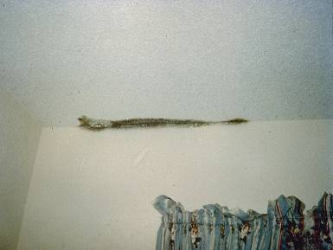
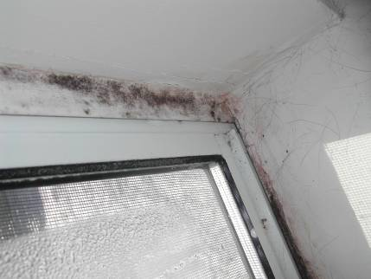
Condensation When Cold Outside
Mold around window where there is no insulation
Mold due to poor insulation or wind blowing through insulation
Notes:
Sometimes, condensation causes moisture problems, usually due to a temperature differential between inside and outside air caused by inadequate insulation.

Slide 23
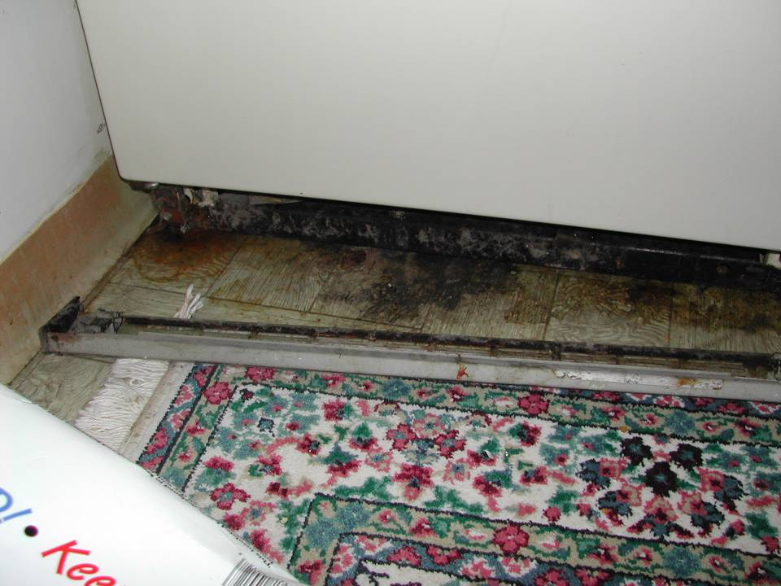
Leaky refrigerator drip pan causes mold
Notes:
Appliances sometimes cause moisture problems.

Slide 24
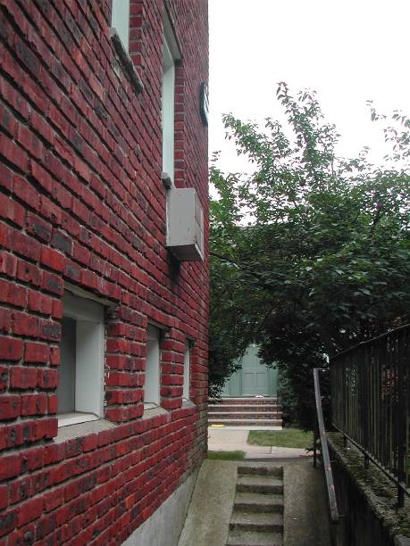
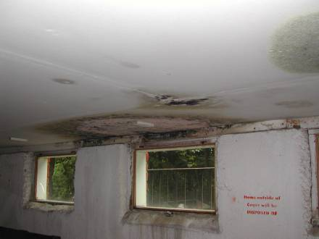
Air conditioner condensation drains into building
Notes:
This air conditioner was installed improperly, with the condensate running into the house.
The photo on the right shows the damage in the apartment downstairs.
So, the first principle of healthy homes is KEEP IT DRY.
Any sign of moisture demands immediate action to diagnose and correct the problem.

